Slide 1


Triton: Past, Present, Future
PHIL TILLET OPENAI

Slide 2
THANKS FOR BEING HERE!

Slide 3
PAST

Slide 4
- 2016: ISAAC
The precursor of Triton was ISAAC, a handwritten PTX generator for GEMM:
Input: 10+ tuning parameters
Output: a PTX string for a (pre-tensor cores) GEMM kernels that follows the specs
Auto-tuning using MLP-based performance model
ISAAC
2016
2017
2019
2020
2021
2022
2023

Slide 5
2017-2019: EARLY DAYS
When presenting ISAAC at the SC17 conference, I felt great shame:
It was doing by hand what a compiler should do automatically
It didn’t generalize beyond GEMM, or to Tensor Cores (a new thing back then)
After my talk, went straight back to my hotel room and started what would become Triton
SC17
ISAAC
2016
2017
2019
2020
2021
2022
2023

Slide 6
2019-2020: MAKING TRITON GOOD ENOUGH - V0.1
Paper rejected many times!
First prototype presented at the MAPL2019 workshop and published on pip
C-based language with custom parser
Internship at OpenAI to work on V100 tensor cores
SC17
MAPL
ISAAC
OpenAI (intern)
2016
2017
2019
2020
2021
2022
2023

Slide 7
2020-2022: MAKING TRITON USEFUL - V1.0
Measuring usefulness is difficult
Metric: maximizing the number of OpenAI hand-written CUDA kernels it can replace
v1.0
MAPL
OpenAI (full-time)
SC17
ISAAC
OpenAI (intern)
2016
2017
2019
2020
2021
2022
2023

Slide 8
2022-2023: MAKING TRITON MAINTAINABLE - V2.0
When trying to make flash attention work, I felt great shame (again):
Abstractions were broken and impossible to fix
Eventually flash attention worked, but the compiler backend had to be rewritten
v2.0
v1.0
MAPL
OpenAI (full-time)
SC17
Flash Attention
ISAAC
OpenAI (intern)
2016
2017
2019
2020
2021
2022
2023

Slide 9
2023-: GROWING THE COMMUNITY
More maintainable codebase has led to the emergence of an amazing community:
`torch.compile`
H100 support
3P backends
PyTorch 2
v2.0
H100
v1.0
MAPL
OpenAI (full-time)
SC17
Flash Attention
ISAAC
3P backends
OpenAI (intern)
2016
2017
2019
2020
2021
2022
2023

Slide 10
“Be scrupulously truthful, even if the truth is inconvenient, for it is more inconvenient when you try to conceal it.”
Bertrand Russell

Slide 11
PRESENT

Slide 12
TECHNICAL STATUS

Slide 13
PERFORMANCE
A100 performance is (overall) quite satisfactory:
Memory-bound workloads often on-par with best known CUDA kernels
Matmul / Flash-Attention (fwd) on-par with best known CUDA kernels
Flash-Attention (bwd) lagging behind SOTA
H100 performance is looking promising:
Matches cuBLAS on large square matrices
Still far behind for many shapes
3P performance is also looking promising:
Next talks will give details

Slide 14
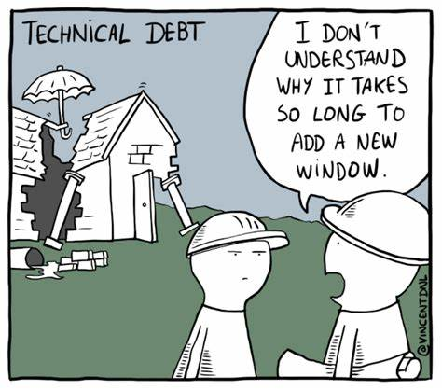

ROBUSTNESS
1 year ago
Today
MLIR Backend

Slide 15
import torch
import triton
import triton.language as tl
@triton.jit
def kernel(X, Y, …, BLOCK: tl.constexpr):
x = tl.load(X + tl.arange(0, BLOCK))
y = tl.load(Y + tl.arange(0, BLOCK))
breakpoint() …
x = torch.arange(1024, device="cuda")
y = torch.arange(1024, device="cuda")
… kernel[(1,)](x, y, …, BLOCK=1024)
DEBUGGING
Major pain point for kernel developers:
Release of an “interpreter mode”
Standard Python debugging workflow
Alpha version was a community contribution(@Mickael Benesty).
Beta version maintained by OpenAI
$ TRITON_INTERPRET=1 python 01-vector-add.py
--Return--
> /root/code/triton/python/tutorials/01-vector-add.py(9) kernel()->None
-> breakpoint() (Pdb)
print(x[7:16])
[ 7 8 9 10 11 12 13 14 15]

Slide 16
REDUNDANCY
H100
TritonNvidiaGPU-IR
BAD
AST
Triton
TritonGPU-IR
LLVM-IR (NVPTX)
plugin
TritonGPU-IR
LLVM-IR
(ROCM)
plugin
TritonGPU-IR
SPIR-V

Slide 17
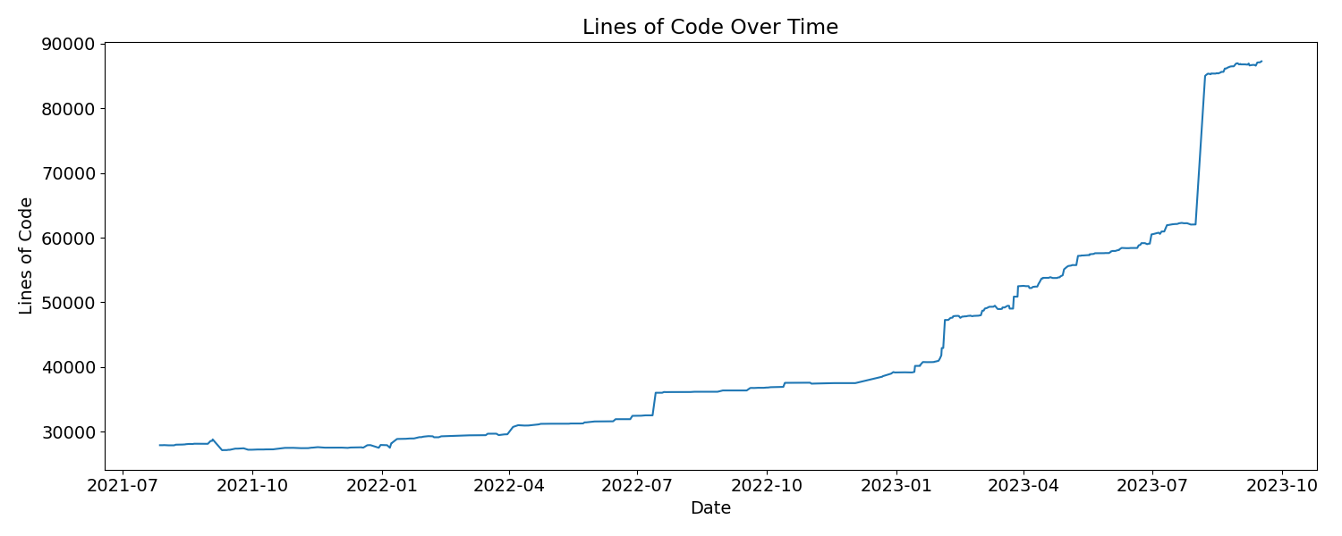
COMPLEXITY
H100
MLIR

Slide 18
COMMUNITY STATUS

Slide 19
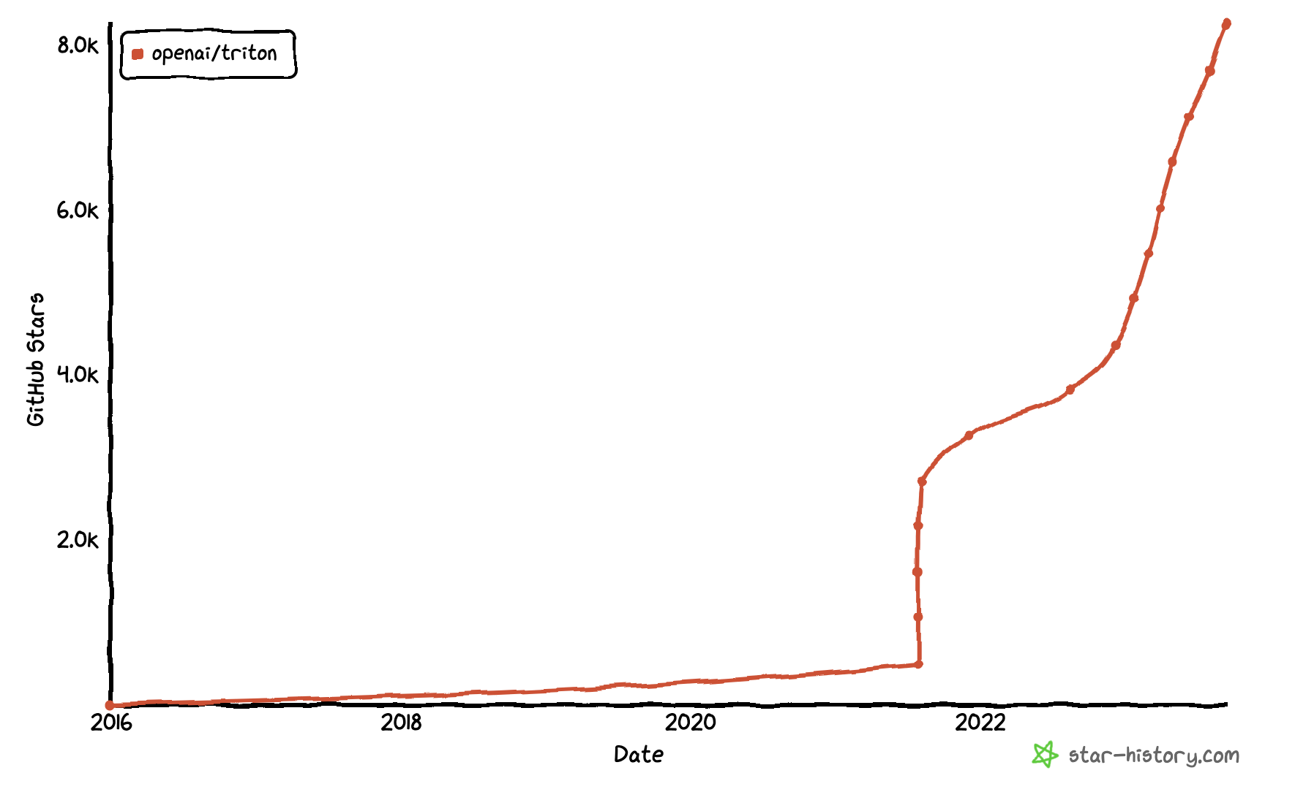
USER GROWTH

Slide 20
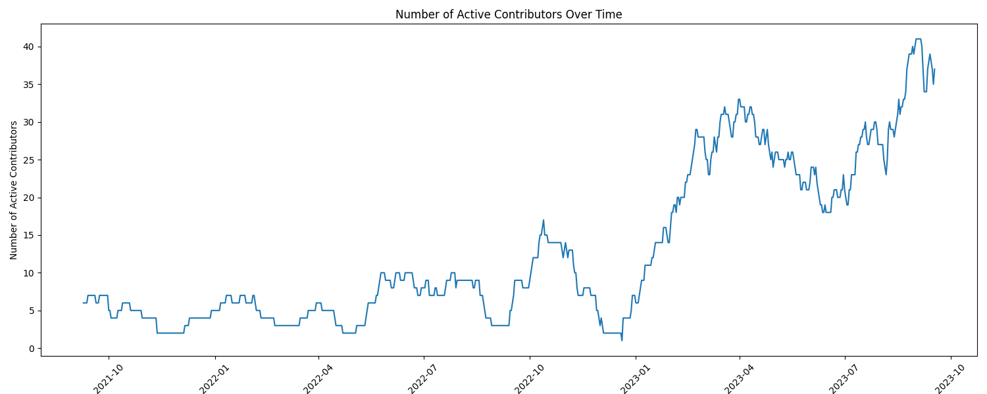
DEVELOPER GROWTH
Private H100 development
H100 lands
PyTorch 2
Private MLIR development
MLIR Done

Slide 21
FUTURE

Slide 22
PERFORMANCE
We need to keep doing what we’ve been doing — for newer hardware:
H100 matrix multiplication on par with cuBLAS for all shapes
H100 attention w/ FP8 support
We need to improve performance where it can be improved:
Minimize extra layout conversions
Improved vectorization
Improved software pipelining

Slide 23
PERFORMANCE
We are here
We want to be here
Triton
Triton
CUDA
CUDA
SASS
SASS

Slide 24
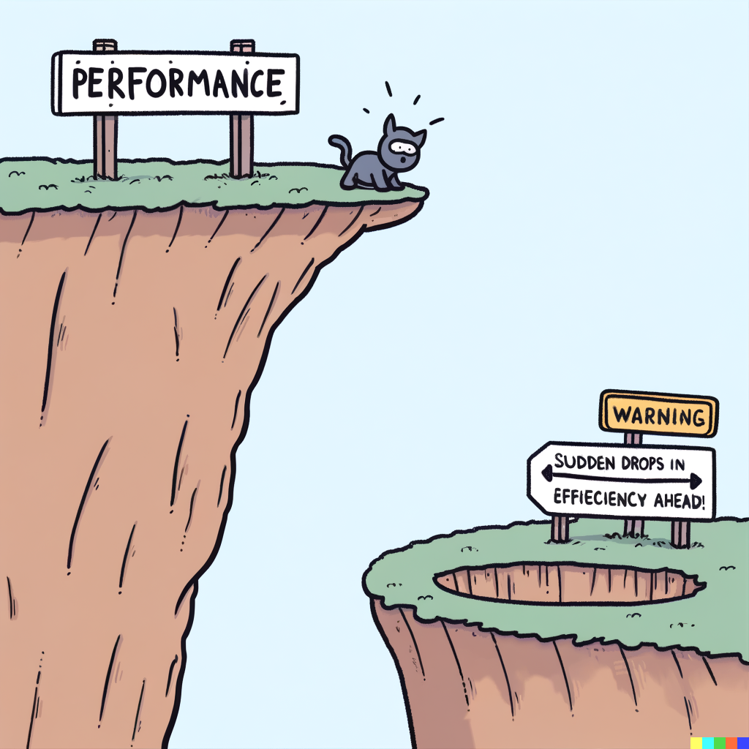
DEBUGGING
Performance cliffs:
Heuristics are notoriously hard to get right
The compiler knows when it can’t optimize
Can it warn the users ?
Provide hints to speed things up?
User tooling:
Production-quality interpreter
Developer tooling:
Better VSCode integration

Slide 25

ROBUSTNESS
Making Triton production-quality, with one unconventional twist:
Performance problems are higher priority than compiler crashes
This means:
More Better tests
Better user experience
Extreme attention to silent failures
Bugs are tolerable if they crash the compiler
Silent failures should be avoided at all costs

Slide 26
REDUNDANCY
H100
TritonNvidiaGPU-IR
AST
Triton
TritonGPU-IR
LLVM-IR (NVPTX)
TTGIR Plugin
LLVM-IR
(ROCM)
TTGIR Plugin
TTIR Plugin
SPIR-V

Slide 27
MANAGING COMPLEXITY
The codebase should be as large as necessary…. But as small as possible:
Refactor TMA abstractions
Refactor Pipeline pass
Trim down math module
Modularize TritonGPU-IR (i.e., separate abstractions for spatial vs temporal parallelism)

Slide 28
“Simplicity is prerequisite for reliability.”
Edsger Dijkstra

Slide 29
THANK YOU FOR YOUR ATTENTION

